Slide 1
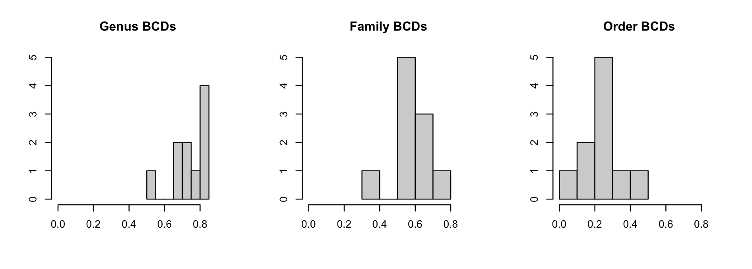

Slide 2
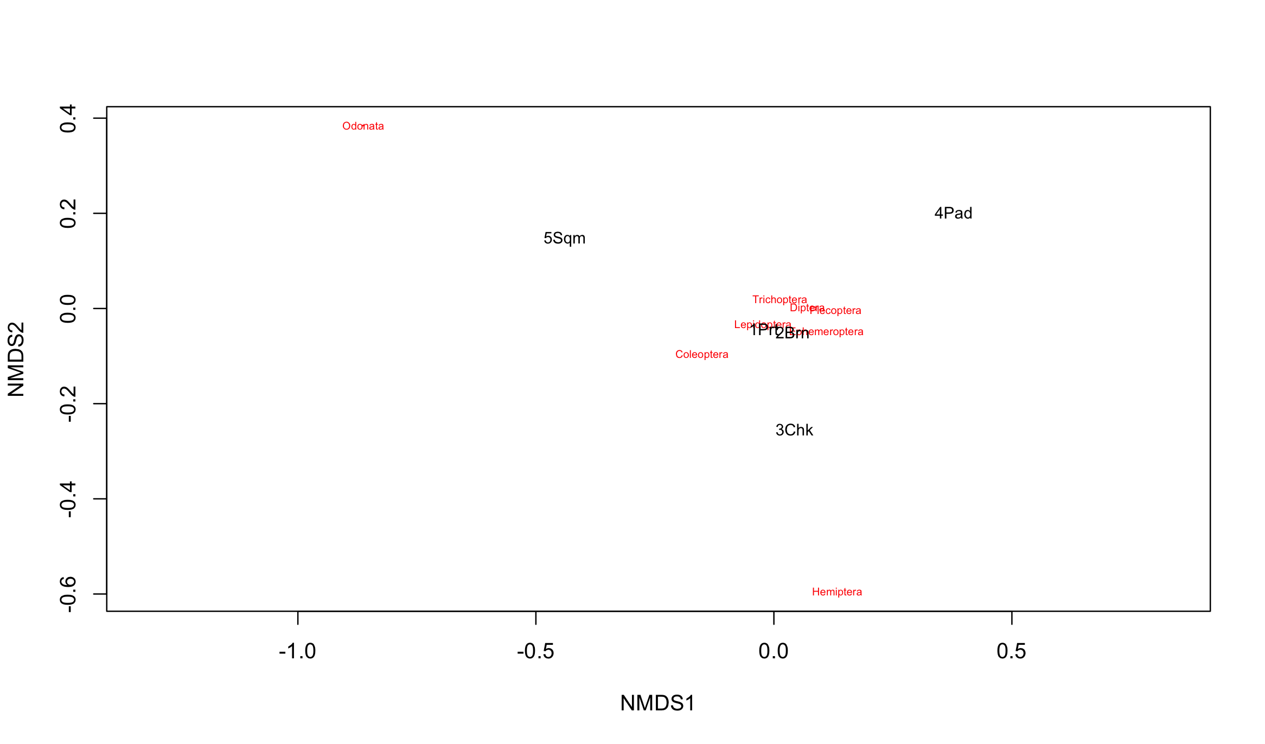
Bray-Curtis Dissimilarity: Order
Dragonflies &
Damselflies
”true bugs,” Cicadas, Aphids etc.

Slide 3
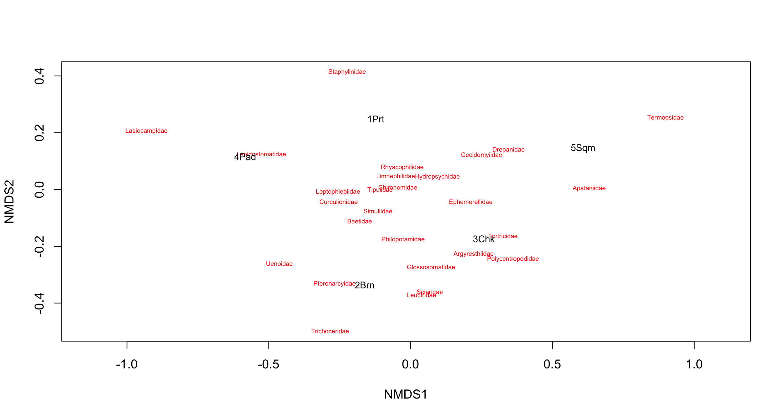
Bray-Curtis Dissimilarity: Family
Rove beetles
Lappet moths

Slide 4
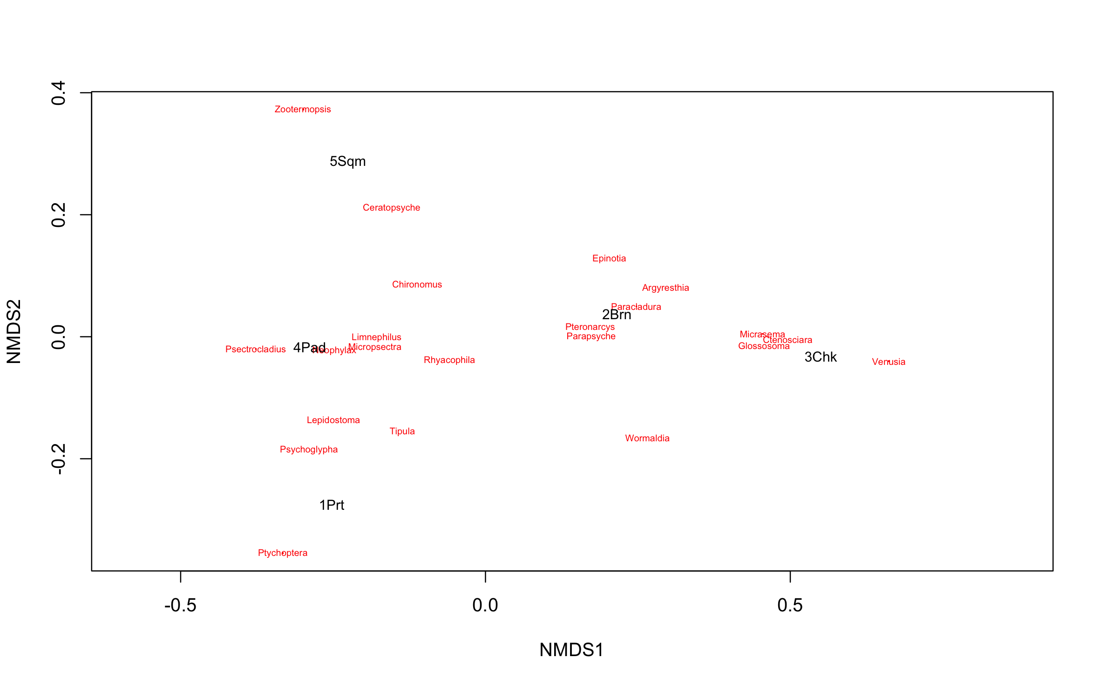
Bray-Curtis Dissimilarity: Genus
Termites
Phantom Crane Flies

Slide 5
Genus Summary from Mar-Apr
Portage | Barnes | Chuckanut | Padden | Squalicum
Drosophila | Limnephilus | Parapsyche | Lepidostoma | Epinotia
Goeracea | Micropsectra | Rhyacophila | Micropsectra | Ceratopsyche
Habrosyne | Pteronarcys | Wormaldia | Tipula | Altica
Hesperoperla | Araeopidius | Argyresthia | Chironomus | Cramptonomyia
Limnephilus | Baetis | Baetis | Malacosoma | Dahlica
Micropsectra | Chionodes | Ctenosciara | Psectrocladius | Pseudothyatira
Onocosmoecus | Chironomus | Epinotia | Limnephilus | Scaphinotus
Psychoglypha | Chyrandra | Glossosoma | Rhyacophila | Zootermopsis
Ptychoptera | Dolophilodes | Micrasema | Psychoglypha | Limnephilus
Rhyacophila | Epinotia | Apatania | Neophylax | Rhyacophila
* 10 common genuses, but not actually ranked (most have mean index of 1?)

Slide 6
Genus Level NMDS Plot of BCDs between Spring (March – April) and Summer (August)
Padden

Slide 7
Genus Level NMDS Plot of BCDs between Spring (March – April) and Summer (August)
Chuckanut

